Slide 1
Introduction and Runtime Analysis
Lecture-1
Md. Golam Shahriar, Lecturer,
Dept. of CSE, VU

Slide 2
What is an Algorithm
Informally, an algorithm is any well-defined computational procedure that takes some value, or set of values, as input and produces some value, or set of values, as output. An algorithm is thus a sequence of computational steps that transform the input into the output.
Algorithms are the ideas behind computer programs
An algorithm is the thing which stays the same whether the program is in assembly language running on a supercomputer in New York or running on a cell phone in Kathmandu in Python!

Slide 3
What Makes an Algorithm, an Algorithm
Must stop after a finite number of steps.
Must be correct.
Must use a finite amount of resources(memory, disks, network bandwidth etc.)
Unambiguous.

Slide 4
Algorithms as a Technology
If computers were infinitely fast and had an infinite amount of memory, than you would not have any reasons to study algorithms.
Since non of it is true, computing time is therefore a bounded resource and so is memory.
So we want our algorithms to use as little time and memory as possible. Because we don’t want to spend an hour waiting for our google maps to navigate us through in light of any serious event or spend a lot of money on smartphones just to run the app.

Slide 5

The Problem of Sorting
Input: sequence of numbers $A=\left\langle a_{1}, a_{2},…a_{N}\right\rangle$
Output: permutation of $A$, $A^{′}$ such that $a_{1}^{′}≤a_{2}^{′}≤…≤a_{N}^{′}$

Slide 6
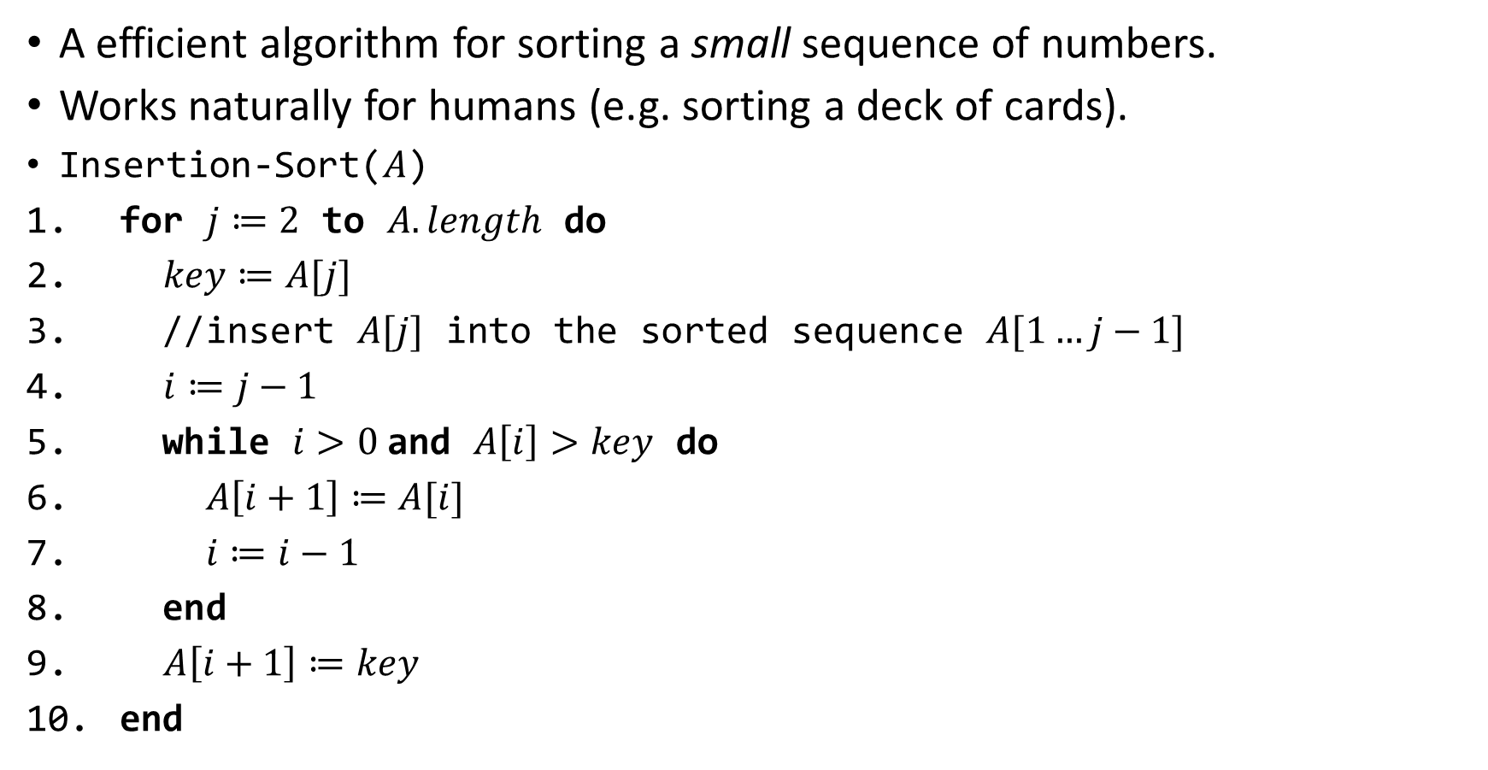
The Insertion Sort Algorithm
A efficient algorithm for sorting a small sequence of numbers.
Works naturally for humans (e.g. sorting a deck of cards).
Insertion-Sort($A$)
for $j≔2$ to $A.length$ do
$key≔A[j]$
//insert $A[j]$ into the sorted sequence $A[1…j−1]$
$i≔j−1$
while $i>0$and $A\left[i\right]>key$ do
$A\left[i+1\right]≔A[i]$
$i≔i−1$
end
$A\left[i+1\right]≔key$
end

Slide 7
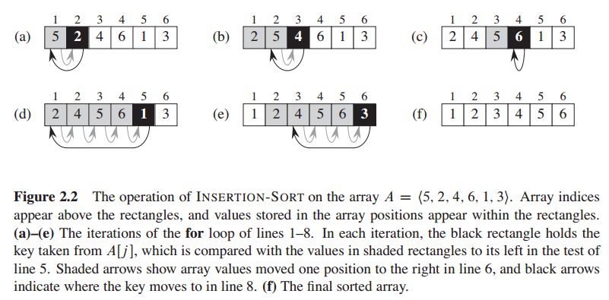
An Execution Snapshot of Insertion Sort

Slide 8
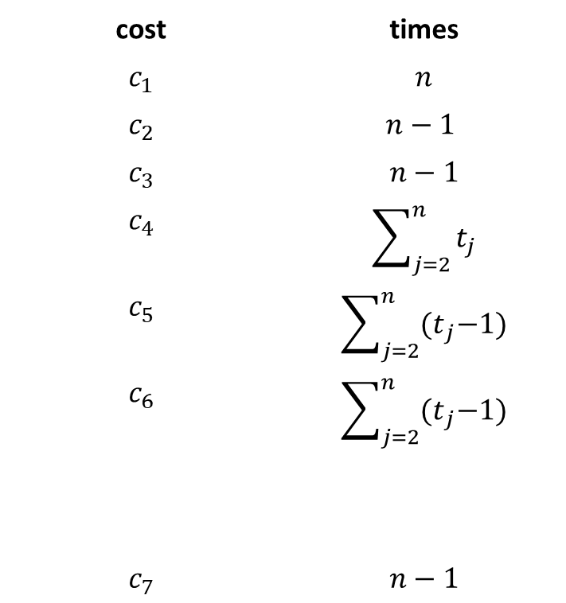

Analysis of The Insertion Sort Algorithm
cost | times
$$c_{1}$$ | $$n$$
$$c_{2}$$ | $$n−1$$
$$c_{3}$$ | $$n−1$$
$$c_{4}$$ | $$\sum_{j=2}^{n}{t_{j}}$$
$$c_{5}$$ | $$\sum_{j=2}^{n}{{(t}_{j}−1)}$$
$$c_{6}$$ | $$\sum_{j=2}^{n}{{(t}_{j}−1)}$$
$$c_{7}$$ | $$n−1$$
Insertion-Sort($A$)
for $j≔2$ to $A.length$ do
$key≔A[j]$
$i≔j−1$
while $i>0$and $A\left[i\right]>key$ do
$A\left[i+1\right]≔A[i]$
$i≔i−1$
end
$A\left[i+1\right]≔key$
end

Slide 9
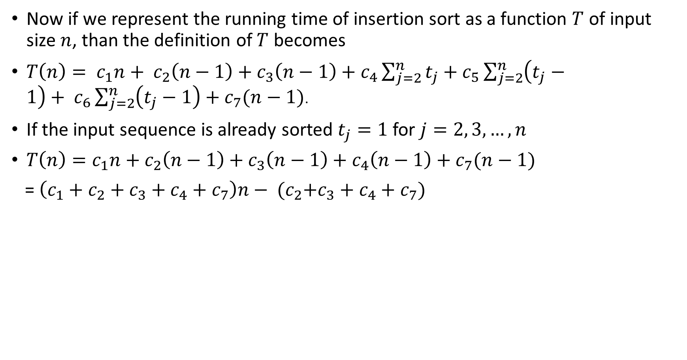
Analysis of The Insertion Sort Algorithm (Best Case)
Now if we represent the running time of insertion sort as a function $T$ of input size $n$, than the definition of $T$ becomes
$T\left(n\right)= c_{1}n+ c_{2}\left(n−1\right)+c_{3}\left(n−1\right)+c_{4}\sum_{j=2}^{n}{t_{j}}+c_{5}\sum_{j=2}^{n}{\left(t_{j}−1\right)+ c_{6}}\sum_{j=2}^{n}{\left(t_{j}−1\right)+c_{7}(n−1)}$.
If the input sequence is already sorted $t_{j}=1$ for $j=2, 3, …, n$
$T\left(n\right)=c_{1}n+c_{2}\left(n−1\right)+c_{3}\left(n−1\right)+c_{4}\left(n−1\right)+c_{7}(n−1)$
= $\left(c_{1}+c_{2}+c_{3}+c_{4}+c_{7}\right)n− {(c}_{2}+c_{3}+c_{4}+c_{7})$

Slide 10
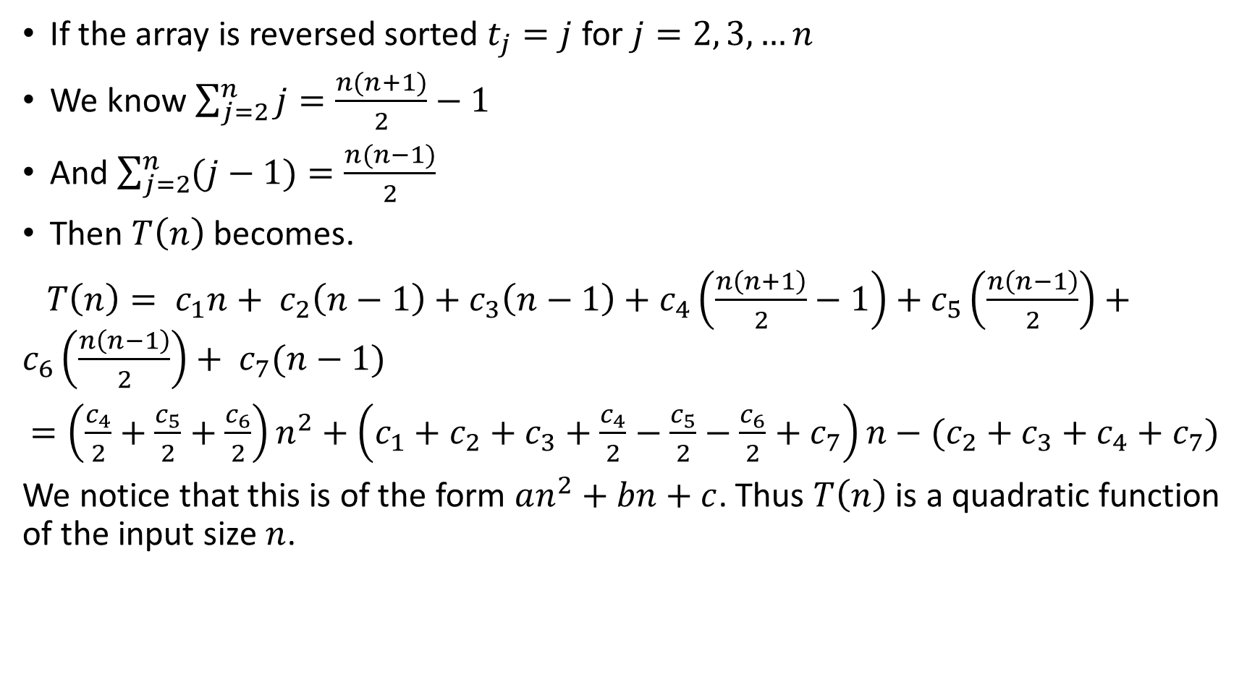
Analysis of The Insertion Sort Algorithm (Worst Case)
If the array is reversed sorted $t_{j}=j$ for $j=2, 3, …n$
We know $\sum_{j=2}^{n}{j}=\frac{n(n+1)}{2}−1$
And $\sum_{j=2}^{n}{(j−1)}=\frac{n(n−1)}{2}$
Then $T\left(n\right)$ becomes.
$T\left(n\right)= c_{1}n+ c_{2}\left(n−1\right)+c_{3}\left(n−1\right)+c_{4}\left(\frac{n\left(n+1\right)}{2}−1\right)+c_{5}\left(\frac{n\left(n−1\right)}{2}\right)+c_{6}\left(\frac{n\left(n−1\right)}{2}\right)+ c_{7}(n−1)$
$=\left(\frac{c_{4}}{2}+\frac{c_{5}}{2}+\frac{c_{6}}{2}\right)n^{2}+\left(c_{1}+c_{2}+c_{3}+\frac{c_{4}}{2}−\frac{c_{5}}{2}−\frac{c_{6}}{2}+c_{7}\right)n−(c_{2}+c_{3}+c_{4}+c_{7})$
We notice that this is of the form $an^{2}+bn+c$. Thus $T\left(n\right)$ is a quadratic function of the input size $n$.

Slide 11
What Do We Mean By Time in this Course?
By time we don’t literally mean time with physical unit of measurements.
Neither we try to measure in how many seconds, minutes or hours, an algorithm finishes its task.
By time here, we mean the number of steps an algorithm takes in order to do its job(we saw this assumption in action previously).
We do so, because literally using time to measure the performance, or rather the efficiency of any algorithm will be highly dependent on the computer that the algorithm runs on and other non dominant factors.

Slide 12
The RAM Model of Computation
Machine-independent algorithm design depends upon a hypothetical computer called the Random Access Machine or RAM. Under this model of computation, we are confronted with a computer where:
Each simple operation (+, *, –, =, if, call) takes exactly one time step(this will change when we are going to analyze number theoretic algorithms).
Loops and subroutines are not considered simple operations. Instead, they are the composition of many single-step operations. It makes no sense for sort to be a single-step operation, since sorting 1,000,000 items will certainly take much longer than sorting 10 items. The time it takes to run through a loop or execute a subprogram depends upon the number of loop iterations or the specific nature of the subprogram.
Each memory access takes exactly one time step. Further, we have as much memory as we need. The RAM model takes no notice of whether an item is in cache or on the disk.
Under the RAM model, we measure run time by counting up the number of steps an algorithm takes on a given problem instance. If we assume that our RAM executes a given number of steps per second, this operation count converts naturally to the actual running time.

Slide 13
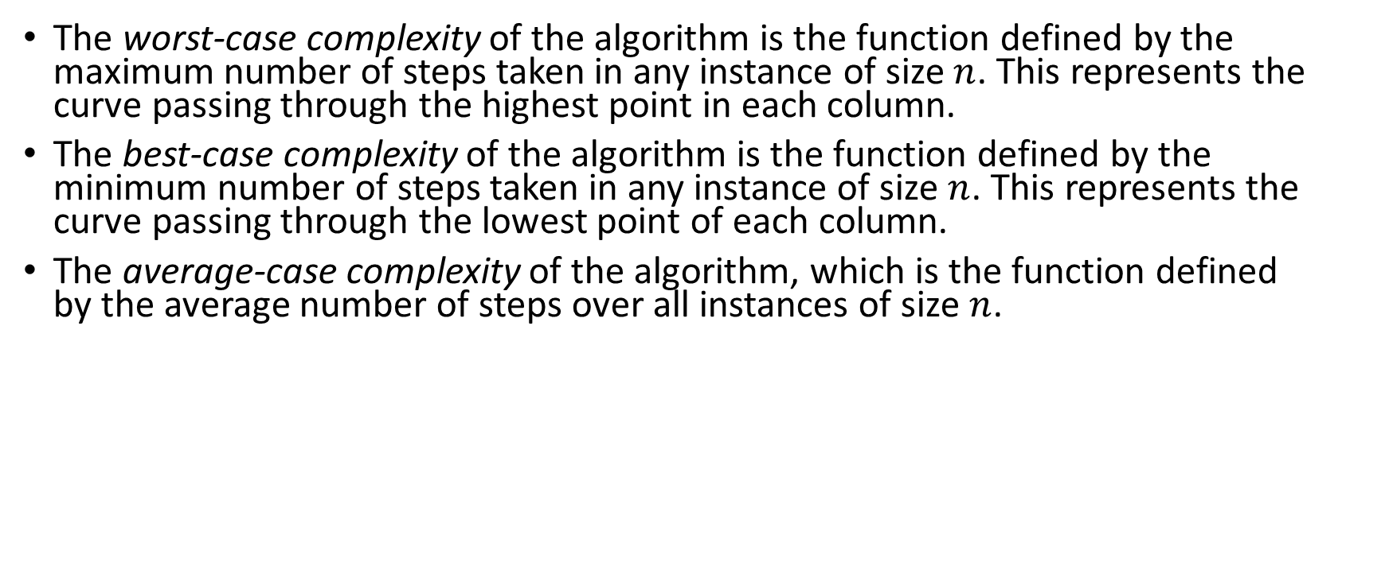
Three Kinds of Runtime Analysis
The worst-case complexity of the algorithm is the function defined by the maximum number of steps taken in any instance of size $n$. This represents the curve passing through the highest point in each column.
The best-case complexity of the algorithm is the function defined by the minimum number of steps taken in any instance of size $n$. This represents the curve passing through the lowest point of each column.
The average-case complexity of the algorithm, which is the function defined by the average number of steps over all instances of size $n$.

Slide 14
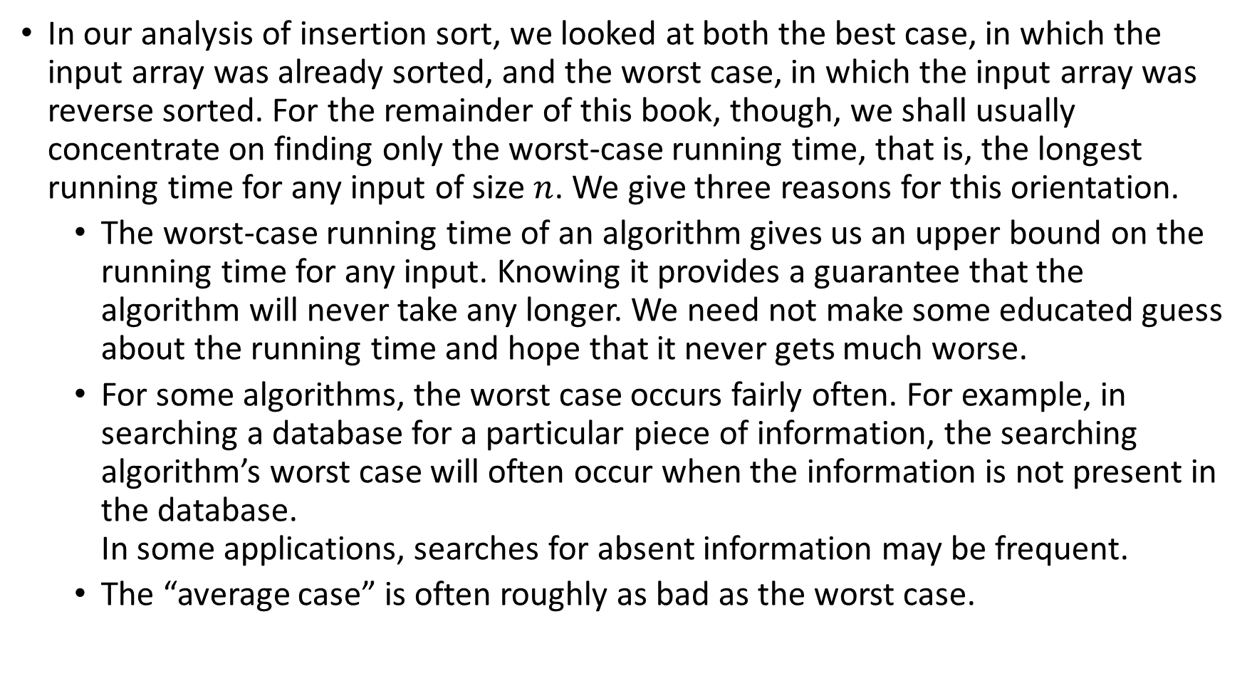
We Are Mostly Concerned About The Worst Case Runtime
In our analysis of insertion sort, we looked at both the best case, in which the input array was already sorted, and the worst case, in which the input array was reverse sorted. For the remainder of this book, though, we shall usually concentrate on finding only the worst-case running time, that is, the longest running time for any input of size $n$. We give three reasons for this orientation.
The worst-case running time of an algorithm gives us an upper bound on the running time for any input. Knowing it provides a guarantee that the algorithm will never take any longer. We need not make some educated guess about the running time and hope that it never gets much worse.
For some algorithms, the worst case occurs fairly often. For example, in searching a database for a particular piece of information, the searching algorithm’s worst case will often occur when the information is not present in the database. In some applications, searches for absent information may be frequent.
The “average case” is often roughly as bad as the worst case.

Slide 15
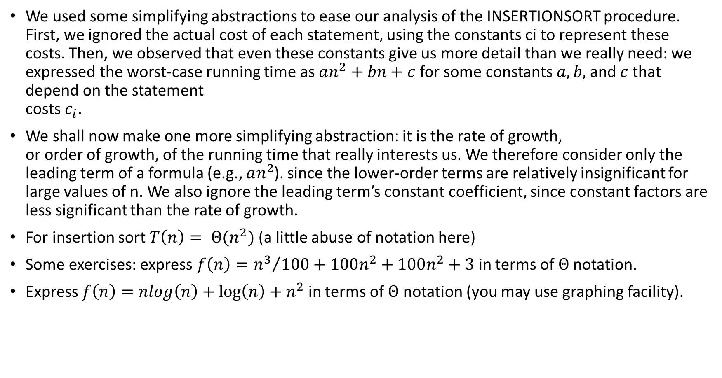
Growth of Functions
We used some simplifying abstractions to ease our analysis of the INSERTIONSORT procedure. First, we ignored the actual cost of each statement, using the constants ci to represent these costs. Then, we observed that even these constants give us more detail than we really need: we expressed the worst-case running time as $an^{2}+bn+c$for some constants $a, b,$and$c$that depend on the statement costs $c_{i}$.
We shall now make one more simplifying abstraction: it is the rate of growth, or order of growth, of the running time that really interests us. We therefore consider only the leading term of a formula (e.g., $an^{2}$). since the lower-order terms are relatively insignificant for large values of n. We also ignore the leading term’s constant coefficient, since constant factors are less significant than the rate of growth.
For insertion sort $T\left(n\right)= Θ(n^{2})$ (a little abuse of notation here)
Some exercises: express $f\left(n\right)={n^{3}}/{100}+100n^{2}+100n^{2}+3$ in terms of $Θ$notation.
Express $f\left(n\right)=nlog\left(n\right)+\log\left(n\right)+n^{2}$ in terms of $Θ$ notation (you may use graphing facility).

Slide 16
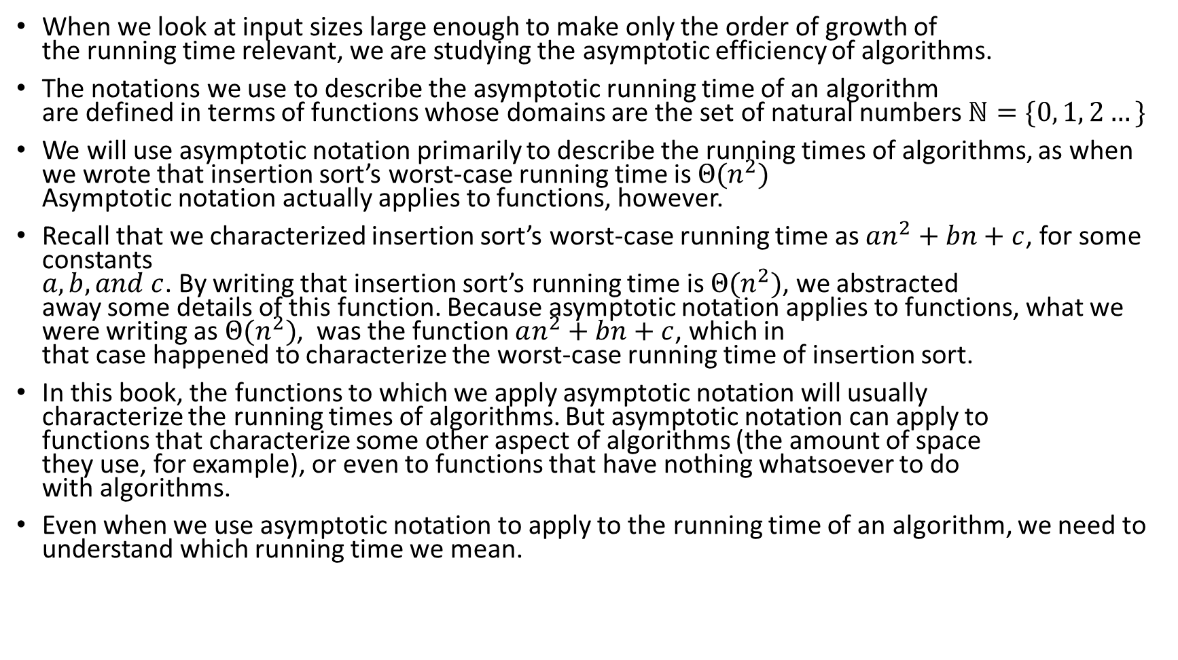
The Asymptotic Notation
When we look at input sizes large enough to make only the order of growth of the running time relevant, we are studying the asymptotic efficiency of algorithms.
The notations we use to describe the asymptotic running time of an algorithm are defined in terms of functions whose domains are the set of natural numbers $ℕ=\{0, 1, 2…\}$
We will use asymptotic notation primarily to describe the running times of algorithms, as when we wrote that insertion sort’s worst-case running time is $Θ(n^{2})$ Asymptotic notation actually applies to functions, however.
Recall that we characterized insertion sort’s worst-case running time as $an^{2}+bn+c$, for some constants $a, b, and c$. By writing that insertion sort’s running time is $Θ(n^{2})$, we abstracted away some details of this function. Because asymptotic notation applies to functions, what we were writing as $Θ(n^{2})$, was the function $an^{2}+bn+c$, which in that case happened to characterize the worst-case running time of insertion sort.
In this book, the functions to which we apply asymptotic notation will usually characterize the running times of algorithms. But asymptotic notation can apply to functions that characterize some other aspect of algorithms (the amount of space they use, for example), or even to functions that have nothing whatsoever to do with algorithms.
Even when we use asymptotic notation to apply to the running time of an algorithm, we need to understand which running time we mean.

Slide 17
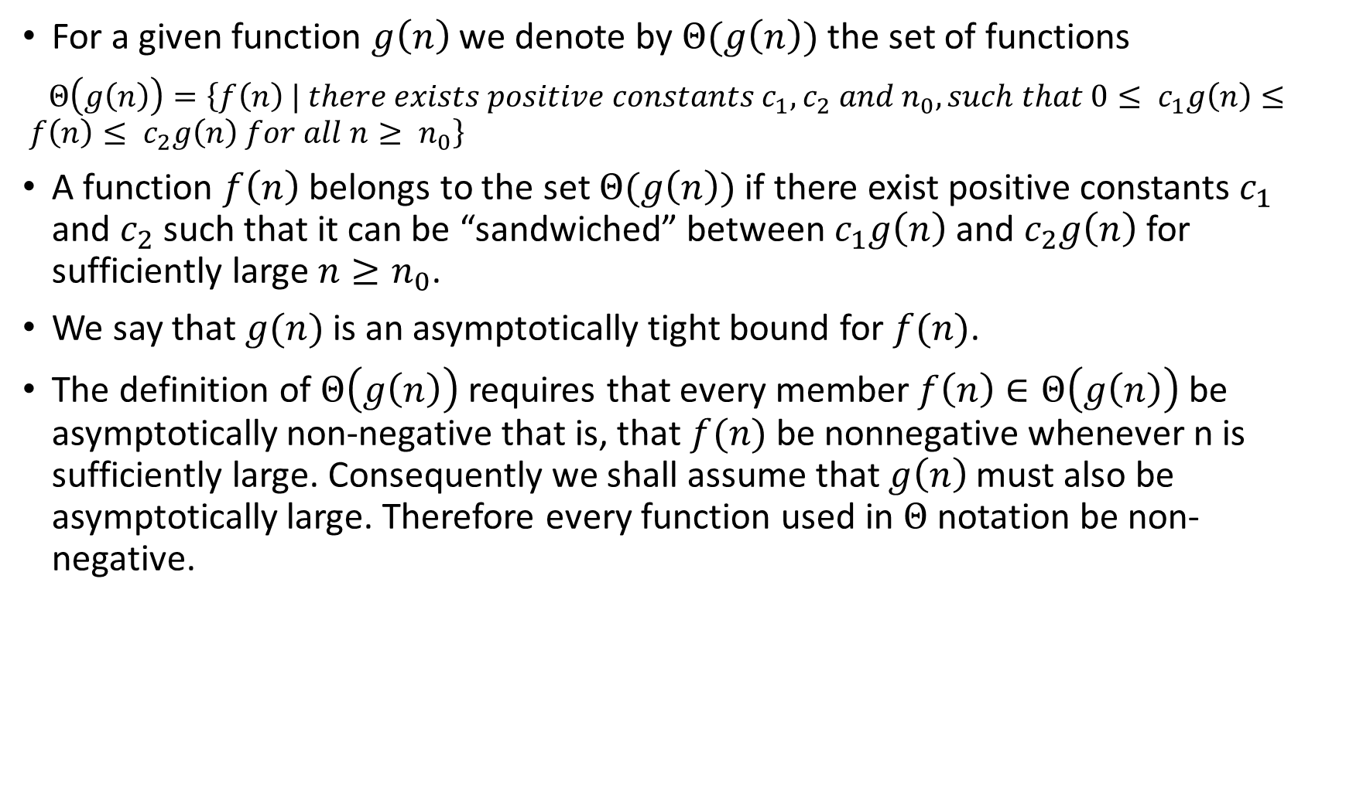
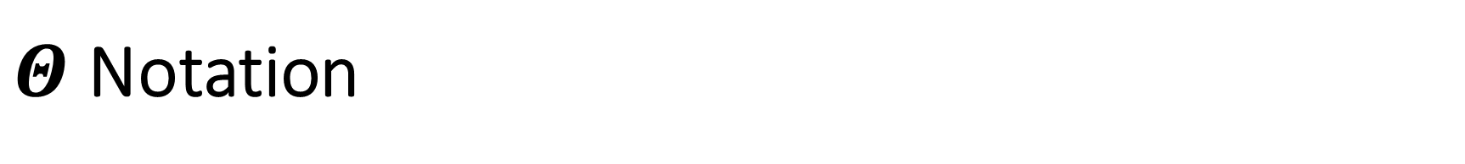
$Θ$Notation
For a given function $g\left(n\right)$ we denote by $Θ(g\left(n\right))$ the set of functions
$Θ\left(g\left(n\right)\right)=\left\{f\left(n\right) | there exists positive constants c_{1}, c_{2} and n_{0}, such that 0≤ c_{1}g\left(n\right)≤ f\left(n\right)≤ c_{2}g\left(n\right) for all n≥ n_{0}\right\}$
A function $f\left(n\right)$ belongs to the set $Θ(g\left(n\right))$ if there exist positive constants $c_{1}$ and $c_{2}$ such that it can be “sandwiched” between $c_{1}g\left(n\right)$ and $c_{2}g\left(n\right)$ for sufficiently large $n≥n_{0}$.
We say that $g(n)$ is an asymptotically tight bound for $f(n)$.
The definition of $Θ\left(g\left(n\right)\right)$ requires that every member $f\left(n\right)∈Θ\left(g\left(n\right)\right)$ be asymptotically non-negative that is, that $f(n)$ be nonnegative whenever n is sufficiently large. Consequently we shall assume that $g\left(n\right)$ must also be asymptotically large. Therefore every function used in $Θ$ notation be non-negative.

Slide 18
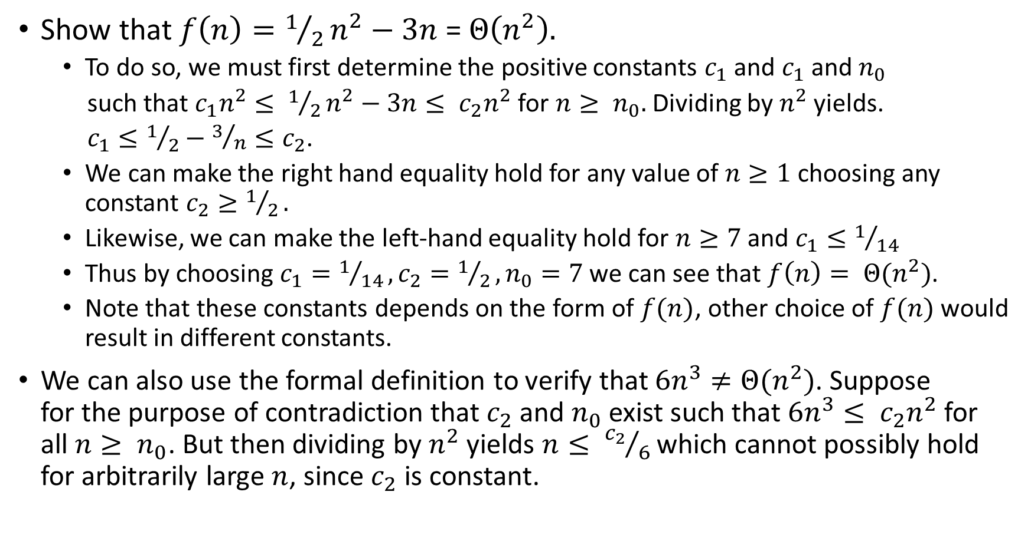
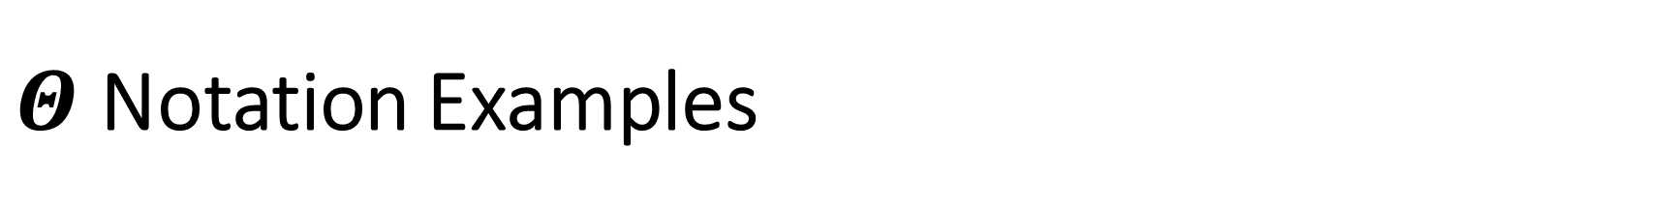
$Θ$Notation Examples
Show that $f\left(n\right)=1/2n^{2}−3n$ = $Θ\left(n^{2}\right).$
To do so, we must first determine the positive constants $c_{1}$ and $c_{1}$ and $n_{0}$
such that $c_{1}n^{2}≤ 1/2n^{2}−3n≤ c_{2}n^{2}$ for $n≥ n_{0}.$ Dividing by $n^{2}$yields.
$c_{1}≤1/2−3/n≤c_{2}$.
We can make the right hand equality hold for any value of $n≥1$ choosing any constant $c_{2}≥1/2.$
Likewise, we can make the left-hand equality hold for $n≥7$ and $c_{1}≤1/{14}$
Thus by choosing $c_{1}=1/{14}, c_{2}=1/2, n_{0}=7$ we can see that $f\left(n\right)= Θ(n^{2})$.
Note that these constants depends on the form of $f(n)$, other choice of $f(n)$ would result in different constants.
We can also use the formal definition to verify that $6n^{3}≠Θ(n^{2})$. Suppose for the purpose of contradiction that $c_{2}$ and $n_{0}$exist such that $6n^{3}≤ c_{2}n^{2}$ for all $n≥ n_{0}$. But then dividing by $n^{2}$ yields $n≤ {c_{2}}/6$ which cannot possibly hold for arbitrarily large $n$, since $c_{2}$ is constant.

Slide 19
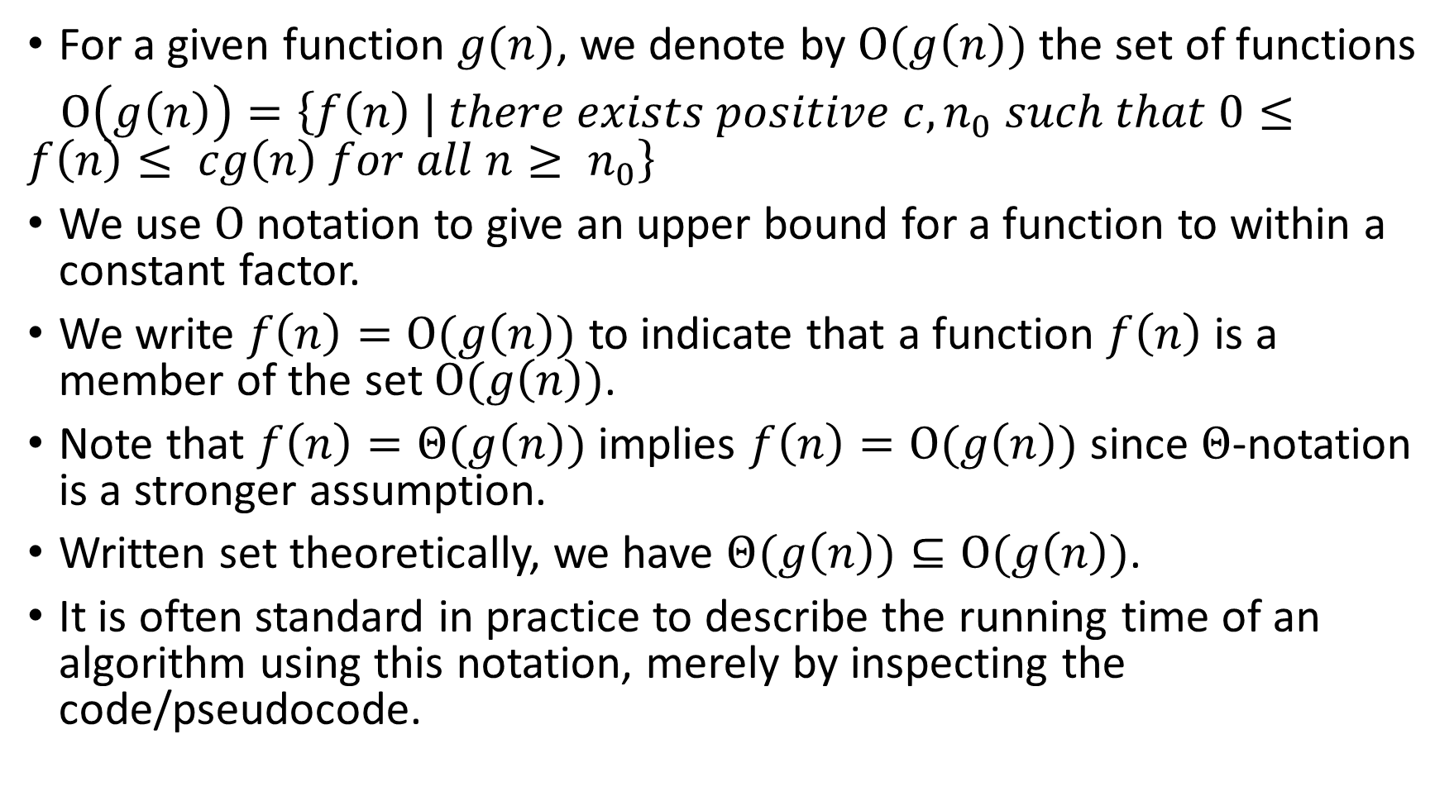
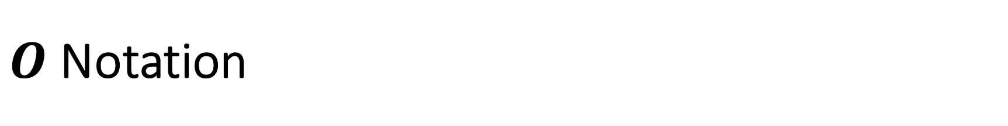
$Ο$ Notation
For a given function $g(n)$, we denote by $O(g\left(n\right))$ the set of functions
$Ο\left(g\left(n\right)\right)=\left\{f\left(n\right) | there exists positive c, n_{0} such that 0≤f\left(n\right)≤ cg\left(n\right) for all n≥ n_{0}\right\}$
We use $Ο$ notation to give an upper bound for a function to within a constant factor.
We write $f\left(n\right)=Ο(g\left(n\right))$ to indicate that a function $f\left(n\right)$ is a member of the set $Ο(g\left(n\right))$.
Note that $f\left(n\right)=Θ(g\left(n\right))$ implies $f\left(n\right)=Ο(g\left(n\right))$ since $Θ$-notation is a stronger assumption.
Written set theoretically, we have $Θ(g\left(n\right))⊆Ο(g\left(n\right))$.
It is often standard in practice to describe the running time of an algorithm using this notation, merely by inspecting the code/pseudocode.

Slide 20
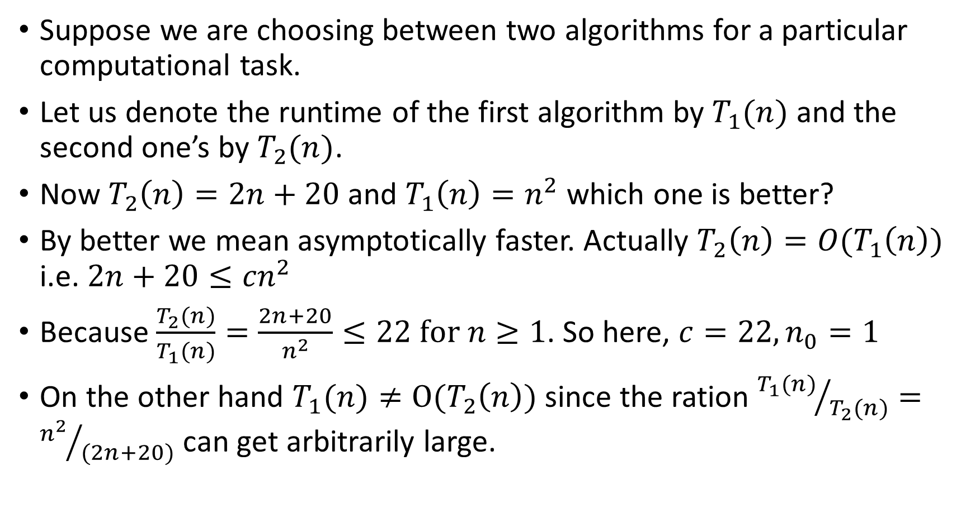
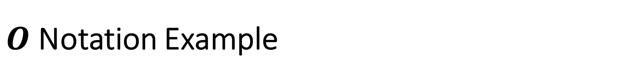
$Ο$ Notation Example
Suppose we are choosing between two algorithms for a particular computational task.
Let us denote the runtime of the first algorithm by $T_{1}(n)$ and the second one’s by $T_{2}(n)$.
Now $T_{2}\left(n\right)=2n+20$ and $T_{1}\left(n\right)=n^{2}$ which one is better?
By better we mean asymptotically faster. Actually $T_{2}\left(n\right)=O(T_{1}\left(n\right))$ i.e. $2n+20≤{cn}^{2}$
Because $\frac{T_{2}(n)}{T_{1}(n)}=\frac{2n+20}{n^{2}}≤22 for n≥1$. So here, $c=22,n_{0}=1$
On the other hand $T_{1}(n)≠Ο(T_{2}\left(n\right))$ since the ration ${T_{1}(n)}/{T_{2}(n)}={n^{2}}/{(2n+20)}$ can get arbitrarily large.

Slide 21
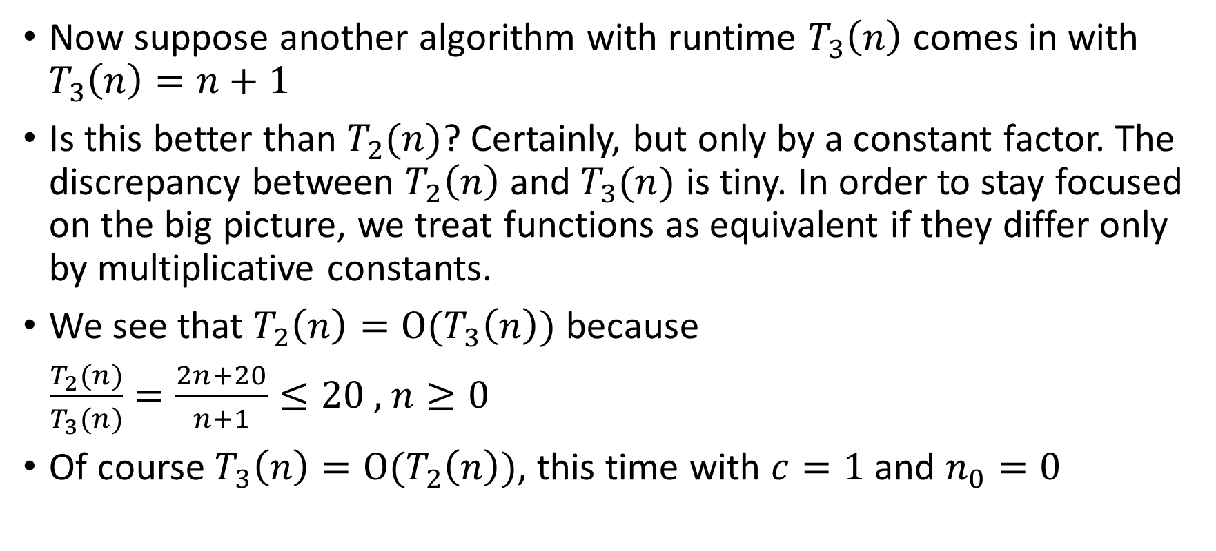
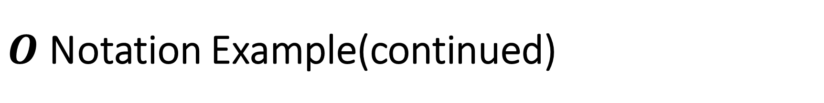
$Ο$ Notation Example(continued)
Now suppose another algorithm with runtime $T_{3}\left(n\right)$ comes in with $T_{3}\left(n\right)=n+1$
Is this better than $T_{2}(n)$? Certainly, but only by a constant factor. The discrepancy between $T_{2}\left(n\right)$ and $T_{3}(n)$ is tiny. In order to stay focused on the big picture, we treat functions as equivalent if they differ only by multiplicative constants.
We see that $T_{2}\left(n\right)=Ο(T_{3}\left(n\right))$ because
$\frac{T_{2}(n)}{T_{3}(n)}=\frac{2n+20}{n+1}≤20 ,$ $n≥0$
Of course $T_{3}\left(n\right)=Ο(T_{2}\left(n\right))$, this time with $c=1$and $n_{0}=0$

Slide 22
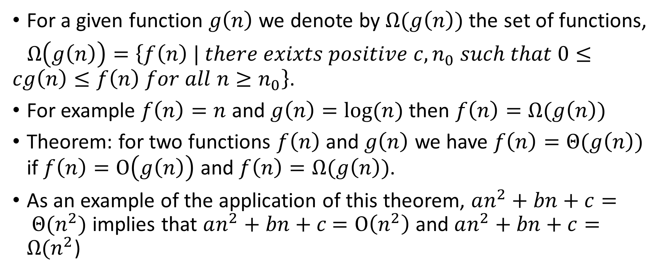
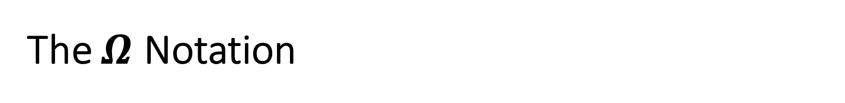
The $Ω$ Notation
For a given function $g\left(n\right)$ we denote by $Ω(g\left(n\right))$ the set of functions,
$Ω\left(g\left(n\right)\right)=\left\{f\left(n\right) | there exixts positive c, n_{0} such that 0≤cg\left(n\right)≤f\left(n\right) for all n≥n_{0}\right\}$.
For example $f\left(n\right)=n$ and $g\left(n\right)=log⁡(n)$ then $f\left(n\right)=Ω(g\left(n\right))$
Theorem: for two functions $f\left(n\right)$ and $g\left(n\right)$ we have $f\left(n\right)=Θ(g\left(n\right))$ if $f\left(n\right)=Ο\left(g\left(n\right)\right)$ and $f\left(n\right)=Ω(g\left(n\right))$.
As an example of the application of this theorem, $an^{2}+bn+c= Θ(n^{2})$ implies that $an^{2}+bn+c$ $=Ο\left(n^{2}\right)$ and $an^{2}+bn+c=Ω(n^{2}$)

Slide 23
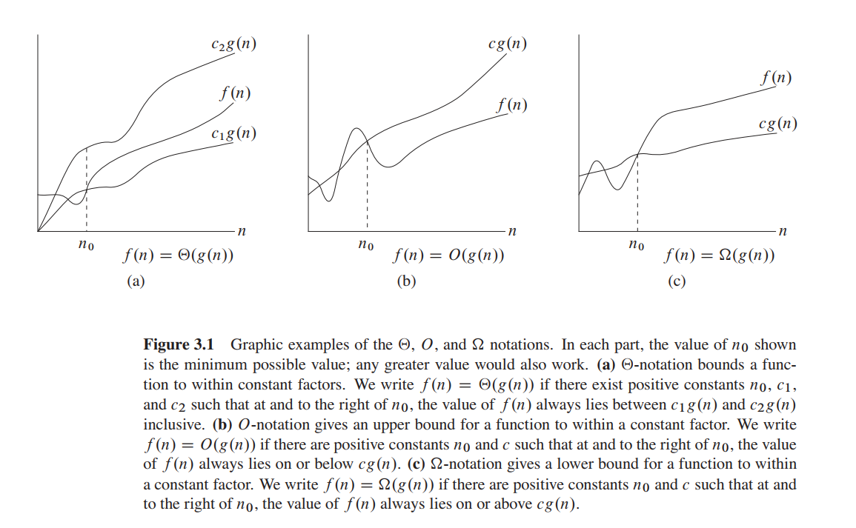

Slide 24
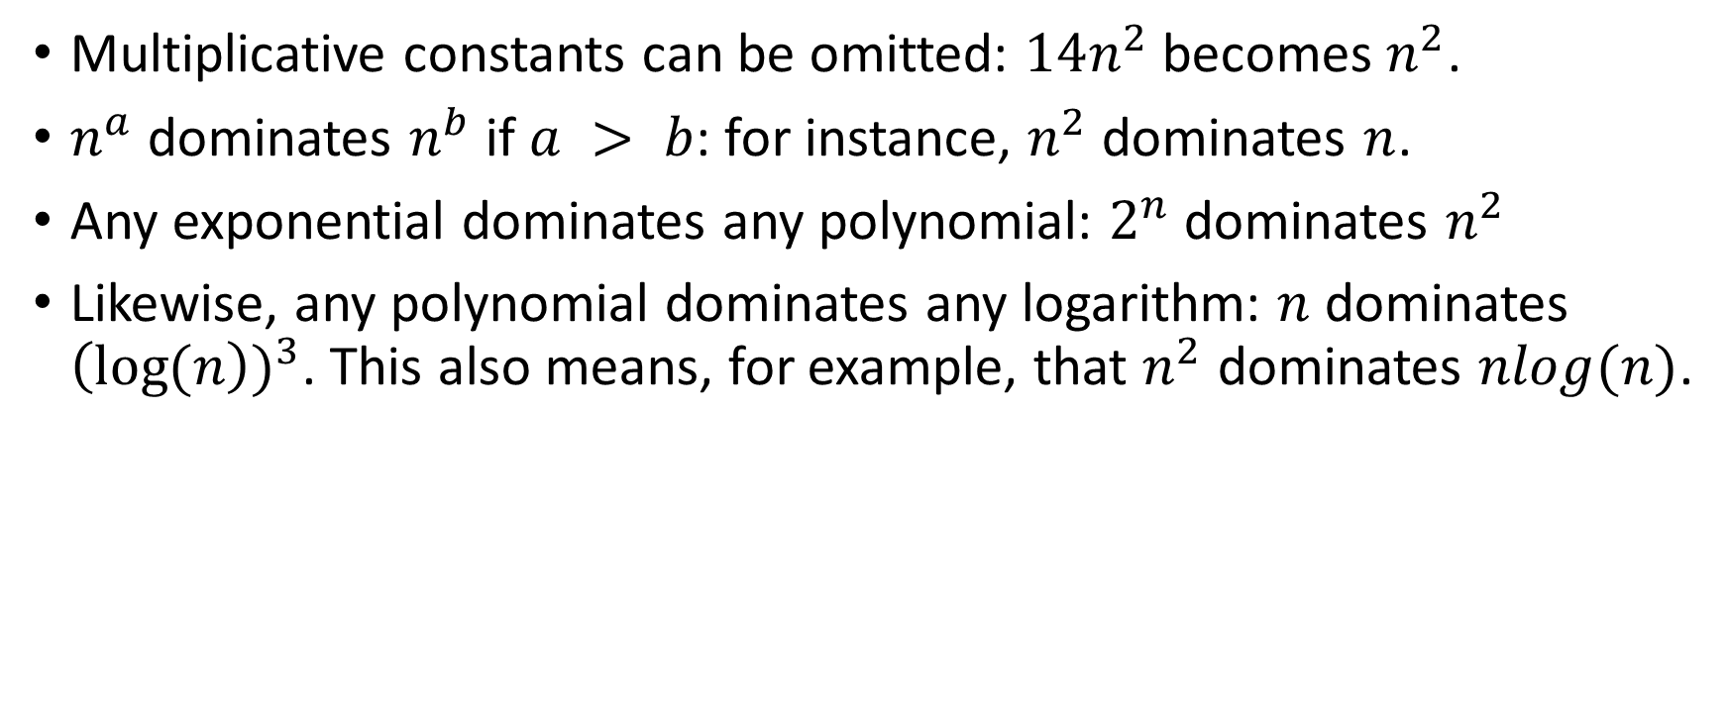
Some Commonsense Rules for Analyzing Your Designed Algorithms in Exams (and Interviews!)
Multiplicative constants can be omitted: $14n^{2}$ becomes $n^{2}$.
$n^{a}$ dominates $n^{b}$ if $a > b$: for instance, $n^{2}$ dominates $n$.
Any exponential dominates any polynomial: $2^{n}$ dominates $n^{2}$
Likewise, any polynomial dominates any logarithm: $n$ dominates ${\left(\log{(n}\right))}^{3}$. This also means, for example, that $n^{2}$ dominates $nlog(n)$.

Slide 25
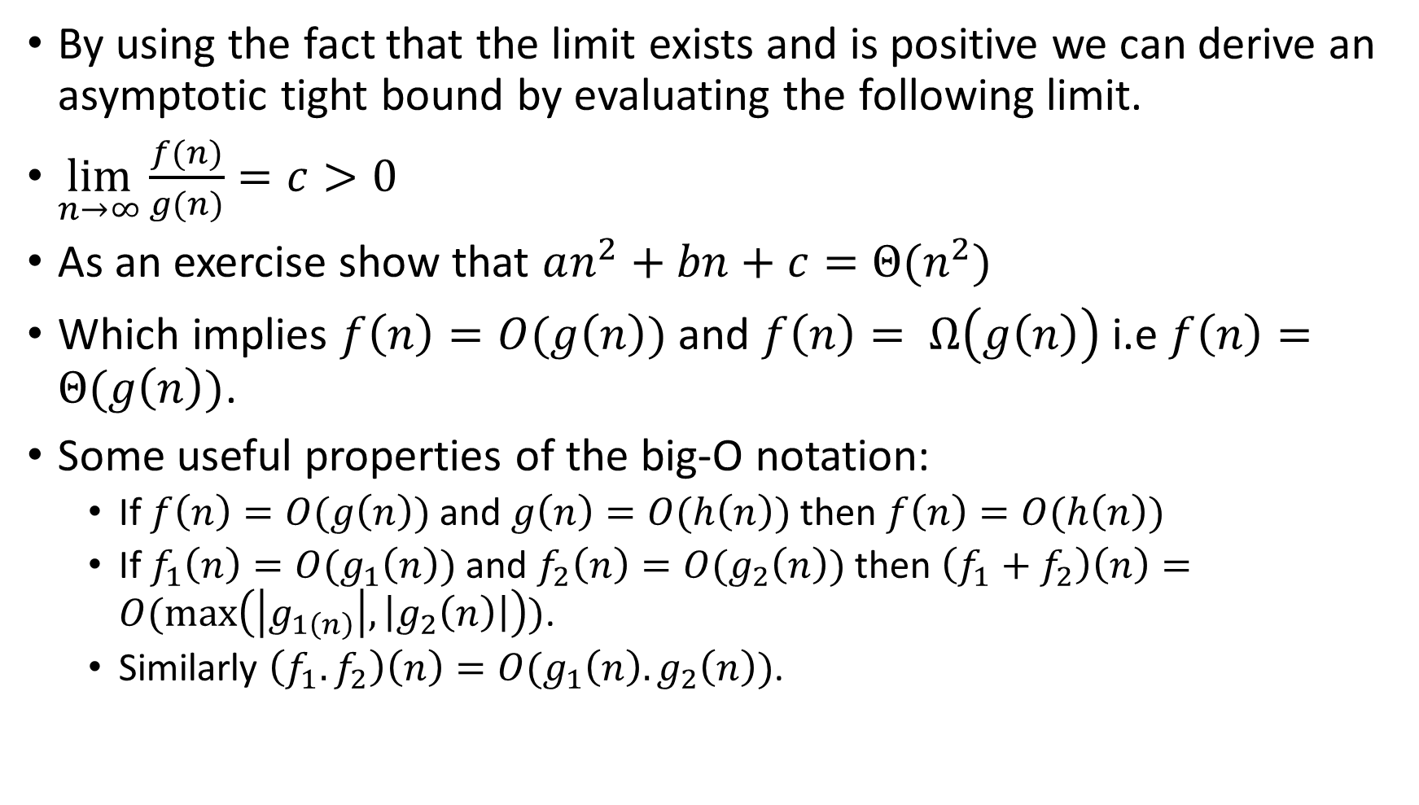
Some Useful Properties and Theorem
By using the fact that the limit exists and is positive we can derive an asymptotic tight bound by evaluating the following limit.
$\lim_{n→∞}{\frac{f(n)}{g(n)}=c>0}$
As an exercise show that $an^{2}+bn+c=Θ(n^{2})$
Which implies $f\left(n\right)=O(g\left(n\right))$ and $f\left(n\right)= Ω\left(g\left(n\right)\right)$ i.e $f\left(n\right)=Θ(g\left(n\right))$.
Some useful properties of the big-O notation:
If $f\left(n\right)=O(g\left(n\right))$ and $g\left(n\right)=O(h\left(n\right))$ then $f\left(n\right)=O(h\left(n\right))$
If $f_{1}\left(n\right)=O(g_{1}\left(n\right))$ and $f_{2}\left(n\right)=O(g_{2}\left(n\right))$ then $\left(f_{1}+f_{2}\right)\left(n\right)=O(\max\left(\left|g_{1\left(n\right)}\right|, \left|g_{2}\left(n\right)\right|\right))$.
Similarly $\left(f_{1}.f_{2}\right)\left(n\right)=O(g_{1}\left(n\right).g_{2}\left(n\right))$.

Slide 26
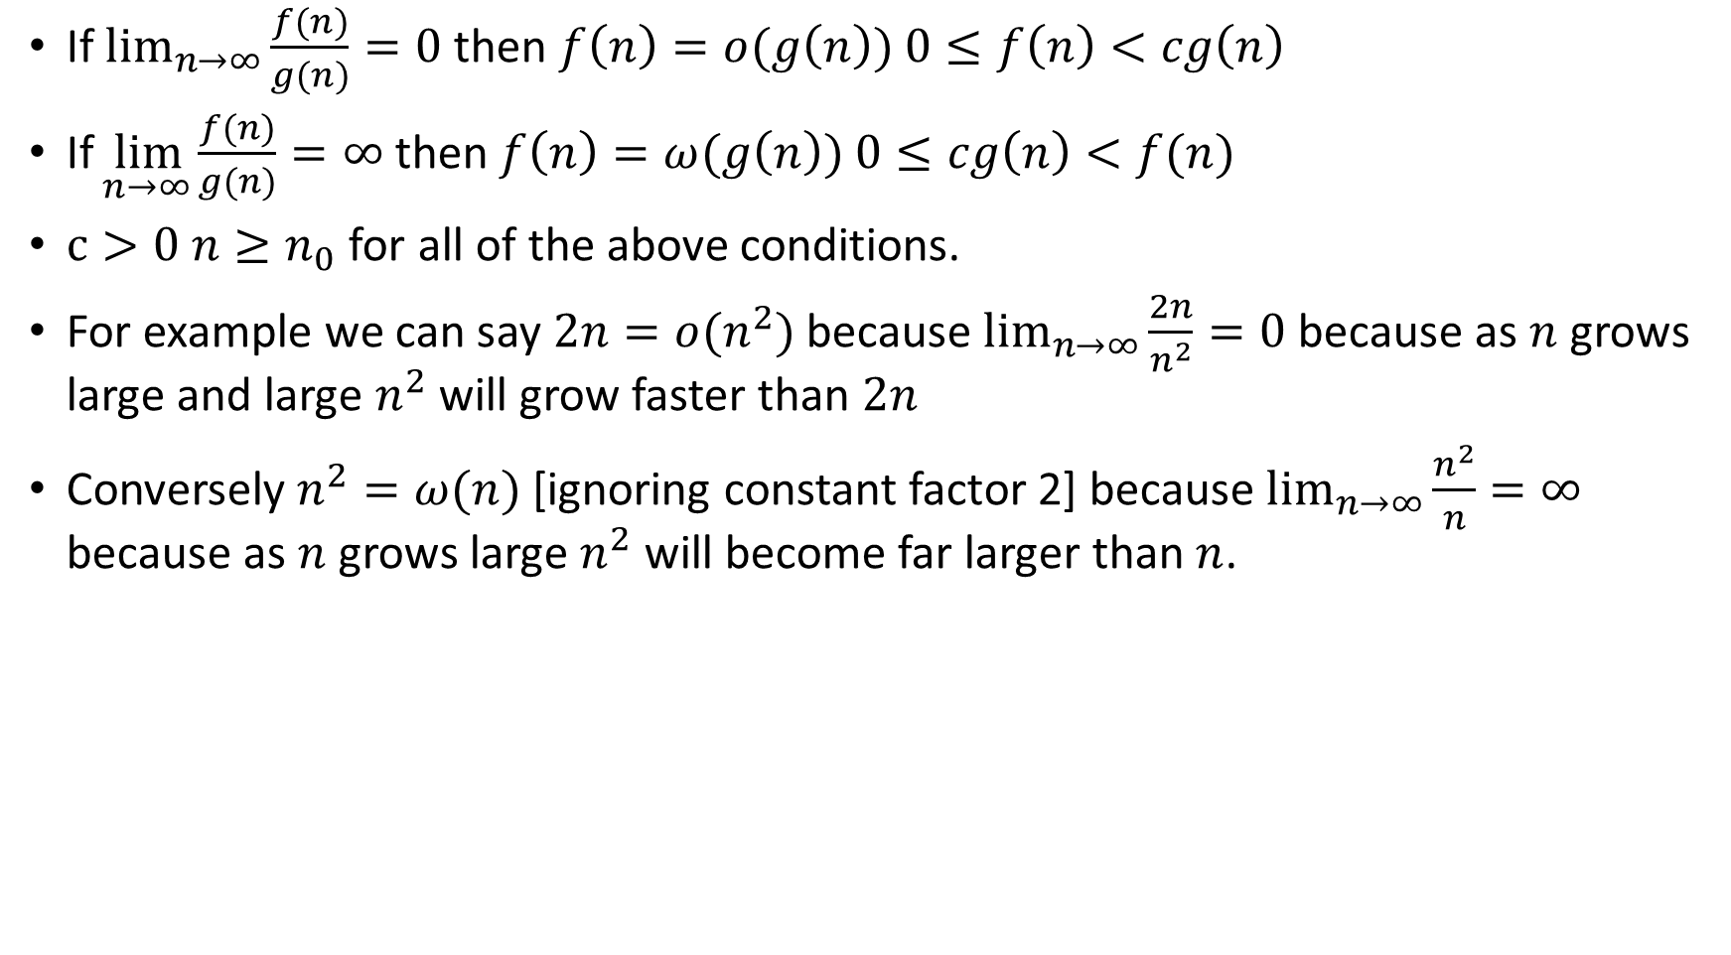
A Few More Helpful Intuitive Notations
If $\lim_{n→∞}{\frac{f(n)}{g(n)}=0}$then $f\left(n\right)=o(g\left(n\right))$ $0≤f\left(n\right)<cg\left(n\right)$
If$\lim_{ n→∞}{\frac{f(n)}{g(n)}=∞}$then $f\left(n\right)=ω(g\left(n\right))$ $0≤cg\left(n\right)<f(n)$
$c>0$ $n≥n_{0}$ for all of the above conditions.
For example we can say $2n=o(n^{2})$ because $\lim_{n→∞}{\frac{2n}{n^{2}}=0}$ because as $n$ grows large and large $n^{2}$ will grow faster than $2n$
Conversely $n^{2}=ω(n)$ [ignoring constant factor 2] because $\lim_{n→∞}{\frac{n^{2}}{n}=∞}$ because as $n$ grows large $n^{2}$ will become far larger than $n$.

